Slide 1
EER Conversion into Tables
Rushali Patil

Slide 2
Redundancy of Schema: Weak Entity Set
E-ID
Ename
Dname
Age
Employee
Relation Schema
emp(EID, ename, dept)
has(EID, dname)
dependents (EID, dname, age, relationship)
Has
Dependents
Dept
Relationship

Slide 3
The Primary Key Selection For Binary Relationship Sets
Many-to-Many: Primary Key->The union of primary key attributes from the participating entity sets
One-to-One: Primary Key->The primary key of either entity set can be chosen (arbitrarily)
Many-to-One/ One-to-Many : Primary Key->The primary key attributes of the entity set on “many” side
n-ary relationship set without arrows on the edges: Primary Key->The union of primary key attributes from the participating entity sets
N-ary relationship set with an arrow on one of its edge: Primary Key->The primary key attributes of the entity sets not on the “arrow” side of the relationship set

Slide 4
For Binary Relationship With Cardinality Ratio m:n
A ( a1 , a2 )
R ( a1 , b1 )
B ( b1 , b2 )
a1
a2
b1
b2
R
A
m
n
B

Slide 5
For Binary Relationship With Cardinality Ratio 1:n
a1
a2
b1
b2
A ( a1 , a2 )
R ( b1 ,a1)
B ( b1 , b2 )
After combining B and R schema
A(a1,a2)
BR(b1,b2,a1)
R
A
B
1
n
b1 is redundant

Slide 6
For Binary Relationship With Cardinality Ratio n:1
a1
a2
b1
b2
A ( a1 , a2 )
R ( a1, b1 )
B ( b1 , b2 )
After combining A and R schema
AR(a1,a2, b1)
B(b1,b2)
R
A
B
n
1
a1 is redundant

Slide 7
For Binary Relationship With Cardinality Ratio 1:1
a1
a2
b1
b2
A ( a1 , a2 )
R ( a1 ,b1)
B ( b1 , b2 )
After combining A and R schema
AR(a1,a2 ,b1)
B(b1,b2)
A ( a1 , a2 )
R ( b1, a1)
B ( b1 , b2 )
After combining B and R schema
A(a1,a2)
BR(b1,b2, a1)
R
A
B
1
1
a1 is redundant
b1 is redundant

Slide 8
Binary Relationship With Cardinality Constraints and Total Participation
a1
a2
b1
b2
Because cardinality ratio = 1 : n , so we will combine the entity set B and relationship set R
Then, two tables will be required-
A ( a1 , a2 )
BR ( a1 , b1 , b2 )
Because of total participation, foreign key a1 has acquired NOT NULL constraint, so it can’t be null now.
R
A
B
1
n

Slide 9
Binary Relationship With Cardinality Constraints and Total Participation
a1
a2
b1
b2
If there is a key constraint from both the sides of an entity set with total participation, then that binary relationship is represented using only single table
ARB ( a1 , a2 , b1 , b2 )
R
A
B

Slide 10
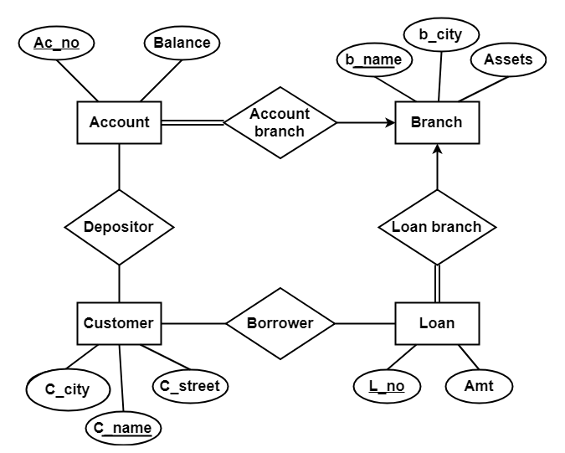
Example

Slide 11
Solution
Account (Ac_no , Balance , b_name)
Branch (b_name , b_city , Assets)
Loan (L_no , Amt , b_name)
Borrower (C_name , L_no)
Customer (C_name , C_street , C_city)
Depositor (C_name , Ac_no)

Slide 12
Mapping Specialization or Generalization Into Schema
Convert each specialization with m subclasses {S1, S2,….,Sm} and generalized superclass C, where the attributes of C are {k,a1,…an} and k is the (primary) key, into relational schemas using one of the four following options:
A: Multiple relations-Superclass and subclasses
B: Multiple relations-Subclass relations only
C: Single relation with one type attribute
D: Single relation with multiple type attributes

Slide 13
Specialization Example
Name
DoB
EID
City
Employee
ISA
Typing Speed
Stream
TGrade
Secretary
Engineer
Technician

Slide 14
Multiple relations-Superclass and subclasses
Create a relation L for C with attributes Attrs(L) = {k,a1,…an} and PK(L) = k.
Create a relation Li for each subclass Si, 1 < i < m, with the attributes Attrs(Li) = {k} U {attributes of Si} and PK(Li)=k
This option works for any specialization (total or partial, disjoint of over-lapping)
employee(EID, name, DoB, city)
secretary(EID, typingSpeed)
technician(EID, Tgrade)
engineer(EID, stream)

Slide 15
Specialization Example
Lincense_Plate_No
Price
VID
Manufacturer
Vehicle
No of Passangers
ISA
Max Speed
tonnage
No of Axle
Car
Truck

Slide 16
Multiple relations-Subclass relations only
Create a relation Li for each subclass Si, 1 < i < m, with the attributes Attr(Li) = {attributes of Si} U {k,a1…,an} and PK(Li) = k.
This option only works for a specialization whose subclasses are total (every entity in the superclass must belong to (at least) one of the subclasses)
Relation Schema
car(VID, price, Lincense_Plate_No, Manufacturer, Max Speed, No_ of_Passangers)
truck(VID, price, Lincense_Plate_No, Manufacturer, No_of_Axle, tonnage)

Slide 17
Single relation with one type attribute
Create a single relation L with attributes Attrs(L) = {k,a1 ,…an } U {attributes of S1 } U…U {attributes of Sm} U {t} and PK(L) = k
The attribute t is called a type (or discriminating) attribute that indicates the subclass to which each tuple belongs
employee(EID, name, DoB, city, typingSpeed, Tgrade, stream,t )

Slide 18
Specialization Example
Name
DoB
EID
City
Employee
ISA
Type
subject
skills
Administrative
Academic
Management

Slide 19
Single relation with multiple type attributes
Create a single relation schema L with attributes Attrs(L) = {k,a1 ,…an } U {attributes of S1 } U…U {attributes of Sm} U {t1 , t2 ,…,tm} and PK(L) = k.
Each ti , 1 < I < m, is a Boolean type attribute indicating whether a tuple belongs to the subclass Si .
This option is for specialization whose subclasses are overlapping
employee(EID, name, DoB, city, type, Aflag, skills, Mflag, subject, Acflag )

Slide 20
Aggregation
Project
Proj_guide
Faculty
Students
Evaluate
Date
Report

Slide 21
Aggregation
Project
Proj_guide
Faculty
Students
Evaluate
Report

Slide 22
Aggregation into Relation Schema
Follow ER conversion rules for all entities and relationships
For relationships:create a schema containing
primary key of the aggregated relationship,
the primary key of the associated entity set
any descriptive attributes
Prj_guide(prjID, SID, FID )
evaluate(prjID, SID, FID ,reportNo, Date)

Slide 23
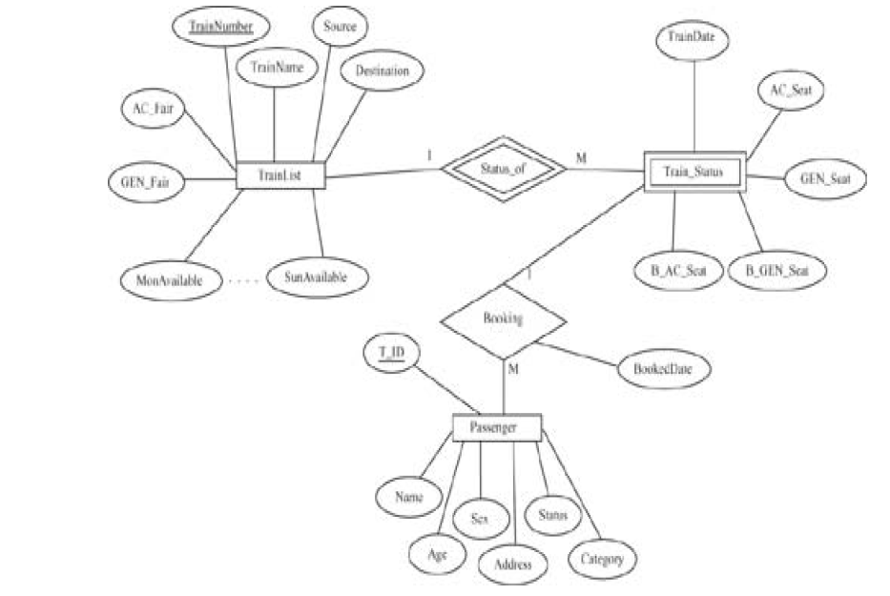
Example

